Slide 1




Open access Open data Open software Open science
@micaelamatta
micaela.matta@kcl.ac.uk
Dr Micaela Matta
Lecturer in Computational Chemistry
King’s College London

Slide 2
Learning objectives
Become familiar with different open access publishing models
Critically evaluate different publishing practices
Develop awareness of the best practices for sharing results and data, as well as the funding regulations around open access
Become familiar with different tools for version control, data sharing and FAIR principles
Become familiar with the open science/software landscape and its real-world impact

Slide 3
Open access

Slide 4



Oct 23 - 29, 2023
https://www.openaccessweek.org
https://github.com/OpenScienceMOOC

Slide 5
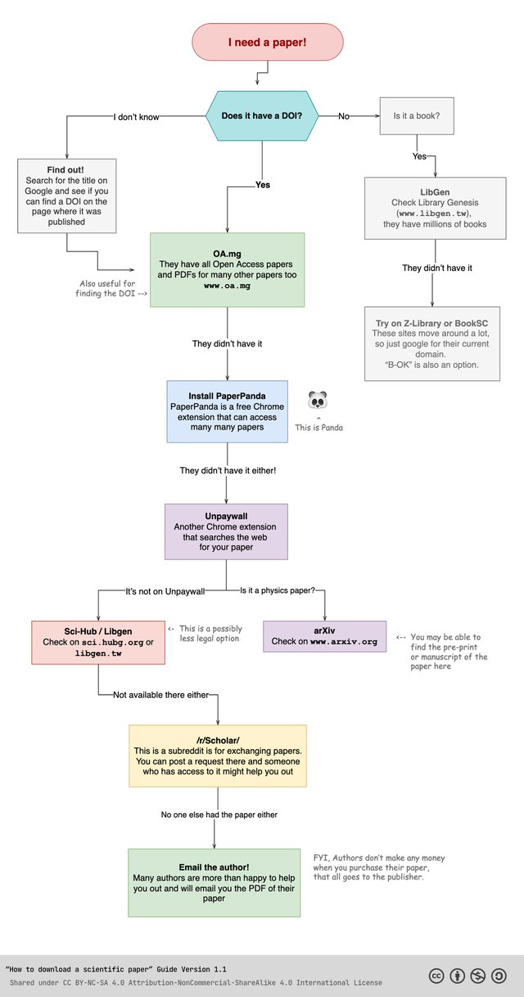
Paper access flowchart

Slide 6
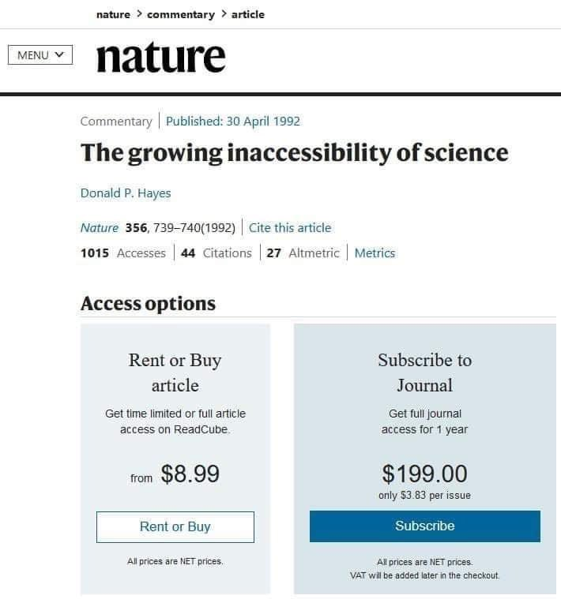
Notes:
https://axial.acs.org/2019/09/18/what-is-peer-review/

Slide 7
..only to find that you could not download it?
Have you ever tried to read a scientific paper..

Slide 8



Open access policies from funders
🇪🇺
Plan S in a nutshell:
Research funded by public money must be made public (via open access)
https://www.coalition-s.org
https://www.ukri.org/news/open-access-policy-update-july-2022/
https://tinyurl.com/3pdjvytw

Slide 9
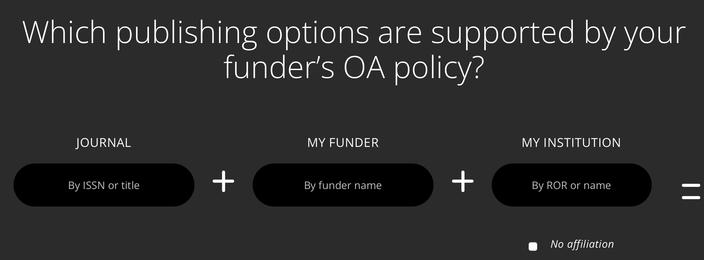
Open access policies from funders
https://journalcheckertool.org

Slide 10
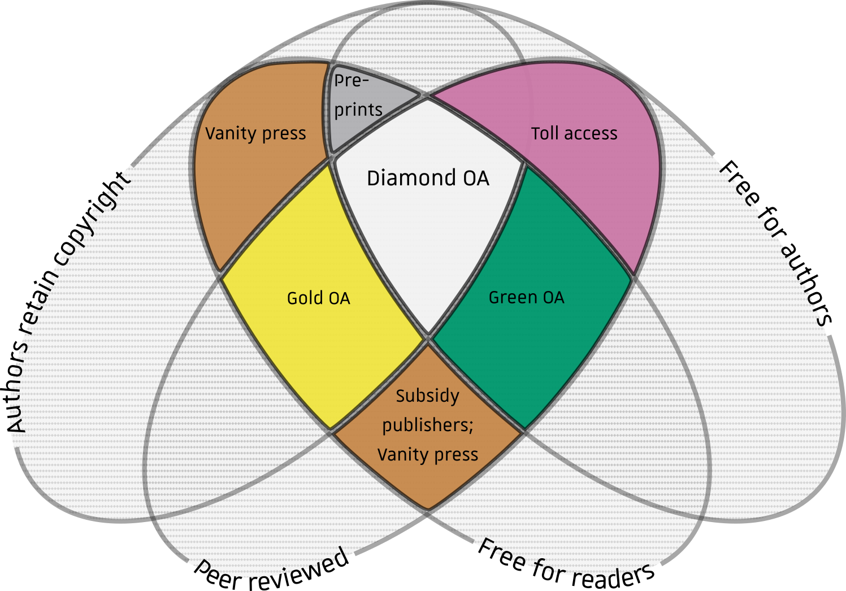
Publishing models and open access options
https://en.wikipedia.org/wiki/Diamond_open_access

Slide 11



.. toll access? .. diamond OA? .. gold OA?
Can you name a chemistry journals that is..
Notes:
JACS = toll

Slide 12
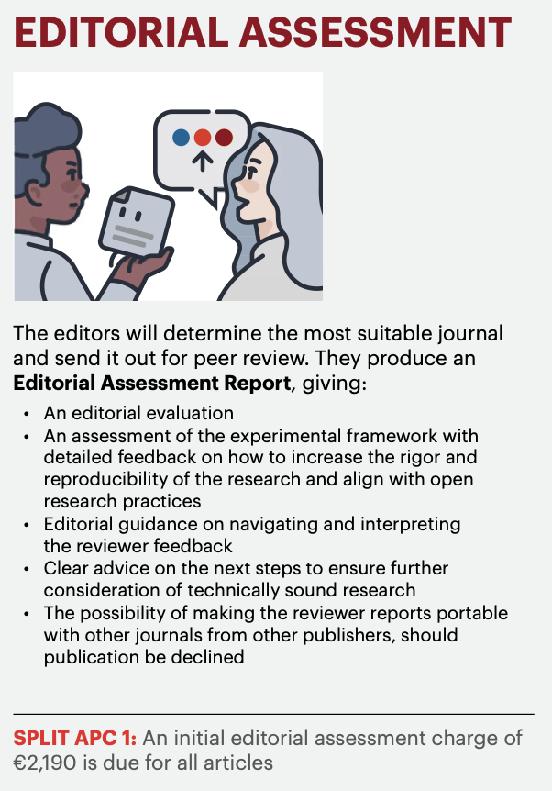


Cost of Open Access
€9,500, US$11,390 or £8,290 for Nature journals
$5,900 for Cell
£4290/$5890/€4890 for Nature communications (original OA journal from Nature Springer)
$3,500 - $4,500 for ACS Au journals
New Nature ‘guided open access’ scheme: €2,190 non-refundable fees, simultaneous consideration at lower tier Nature journals
https://www.nature.com/articles/d41586-021-00271-0

Slide 13

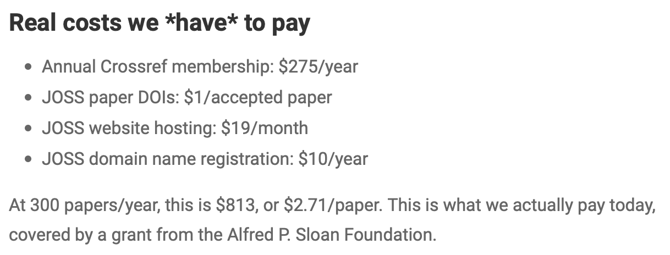
Cost of Open Access
The Journal of Open Source Software (JOSS) costs about $2.71 per article.
https://blog.joss.theoj.org/2019/06/cost-models-for-running-an-online-open-journal

Slide 14

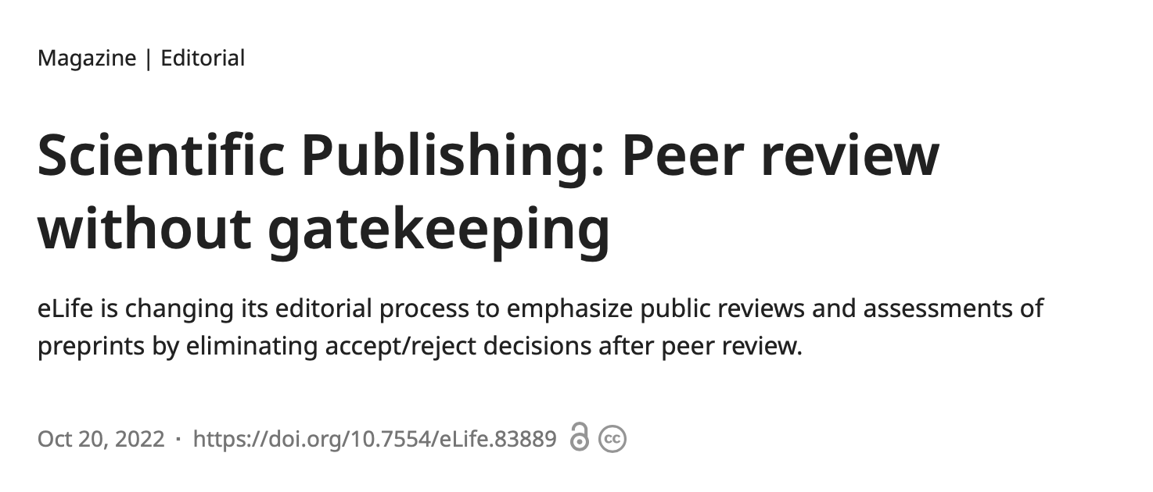
New model: no more rejections
$3,000*
publishing fee 👀
*they offer discounts
Authors should be able to share their work freely and openly when they think it is ready.
01
Peer review should consist of scientists publicly sharing their assessments of already published papers, either under […] an editorial organization[…], or on their own.
02
Works of science should be reviewed by multiple relevant groups and individuals throughout their useful lifespan.
03

Slide 15
Should there be a financial incentive for peer-reviewers? What could the consequences be?
Peer reviewers don’t receive any compensation.*
*Except for some limited grant reviewing schemes.. But journal peer reviewing is not compensated! We just do it for karma, basically.

Slide 16
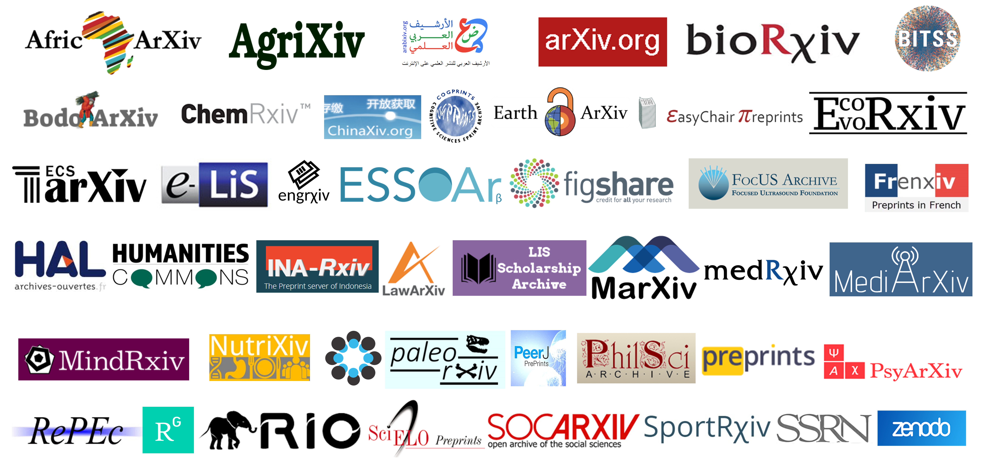
Preprint servers
Digital repositories where anyone can deposit paper drafts, usually at 2 moments:
> Just before they submit to a journal (not peer reviewed draft)
> After peer-review is done

Slide 17
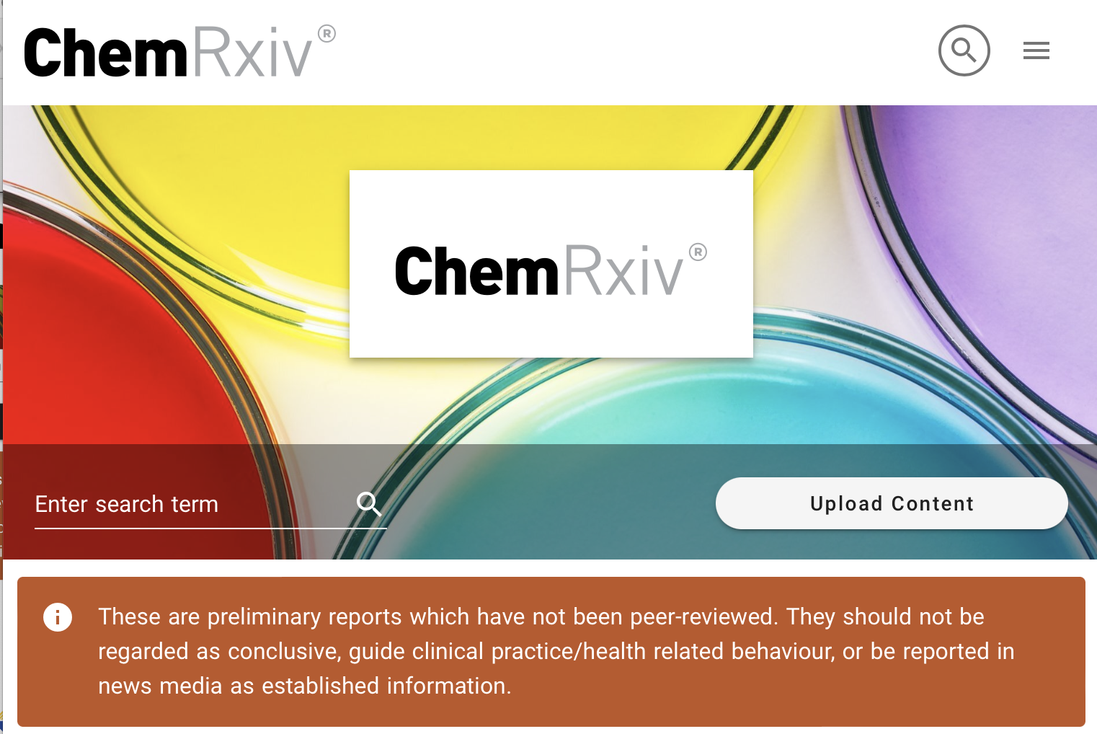
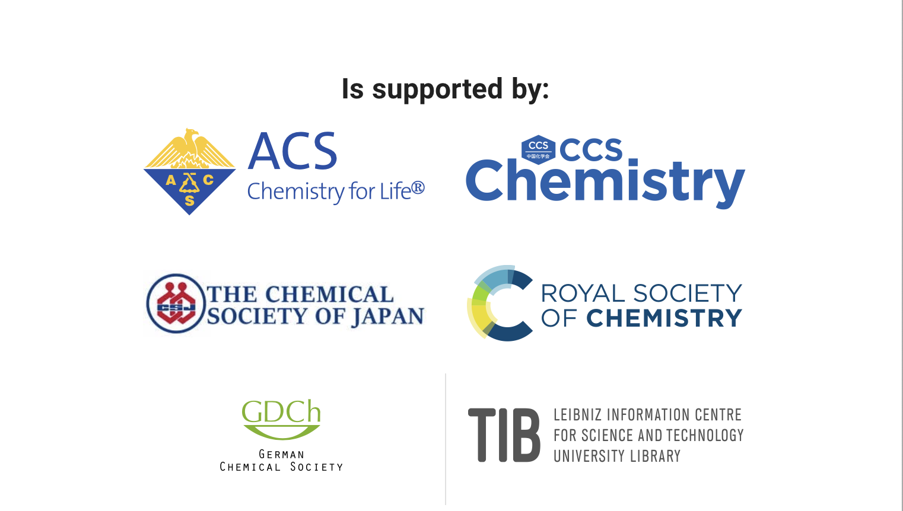

Slide 18
Positive aspects of preprints
Rapid dissemination to a wider audience
Performing corrections via revised versions
Immediate visibility of research and facilitate networking
Demonstration of research progress, particularly for early-career researchers
Availability for wider feedback/review from the research community
Establishment of precedence or intellectual priority
Publishing of all research findings and conditions, including negative results
Potential citation advantage due to earlier and wider availability of research
Publishing Open Access even with limited or no funds -> Green OA
Notes:
https://www.science.org/content/article/you-ve-spotted-flaw-top-journal-s-paper-good-luck-getting-your-critique-published

Slide 19
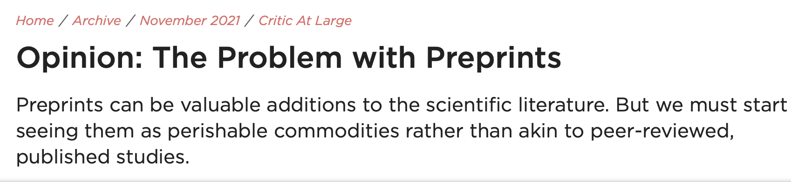
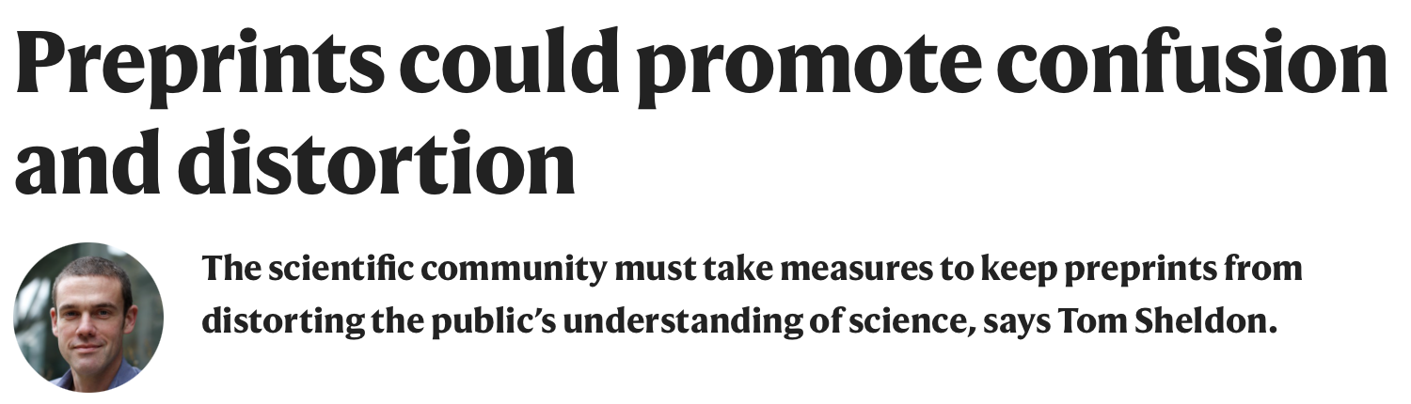
Against preprinting
Preprints may give authors incentives to skip the scrutiny of peer review
Flood of publications of low quality
Risk of being scooped before peer review
Risk of weak studies receiving disproportionate attention, reporting of unverified data by the lay media

Slide 20
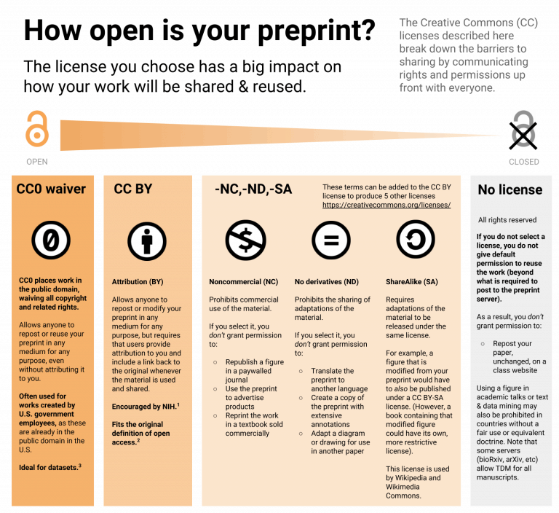
https://asapbio.org/new-licensing-resources

Slide 21
Is peer review always a guarantee of quality?
How can you judge the quality of an open access journal?

Slide 22
Predatory Open Access Journals/Publishers
Little or no peer review or quality control, resulting in hoax and nonsensical papers.
Notifying academics of article fees only after papers are accepted.
Aggressively campaigning for academics to submit articles or serve on editorial boards.
Listing academics as members of editorial boards without their permission
Not allowing academics to resign from editorial boards
Appointing fake academics to editorial boards.
Mimicking name or web site style of more established journals.
Making misleading claims about the publishing operation, such as a false location.
Fake or non-existent impact factors.
https://en.wikipedia.org/wiki/Predatory_publishing
https://beallslist.net
https://guides.umd.umich.edu/c.php?g=813057&p=5801511

Slide 23
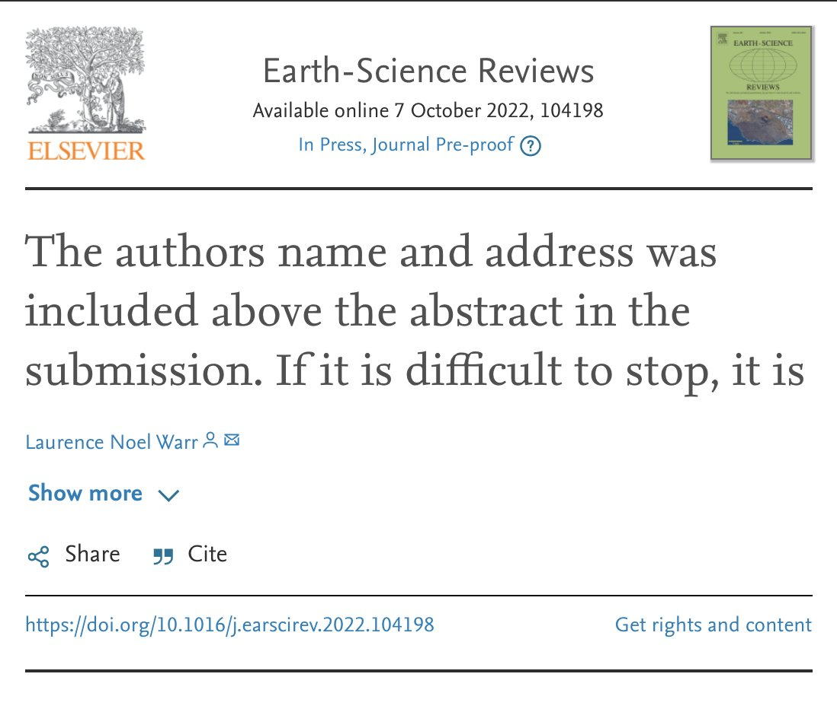
https://en.wikipedia.org/wiki/Predatory_publishing
https://beallslist.net
https://guides.umd.umich.edu/c.php?g=813057&p=5801511

Slide 24
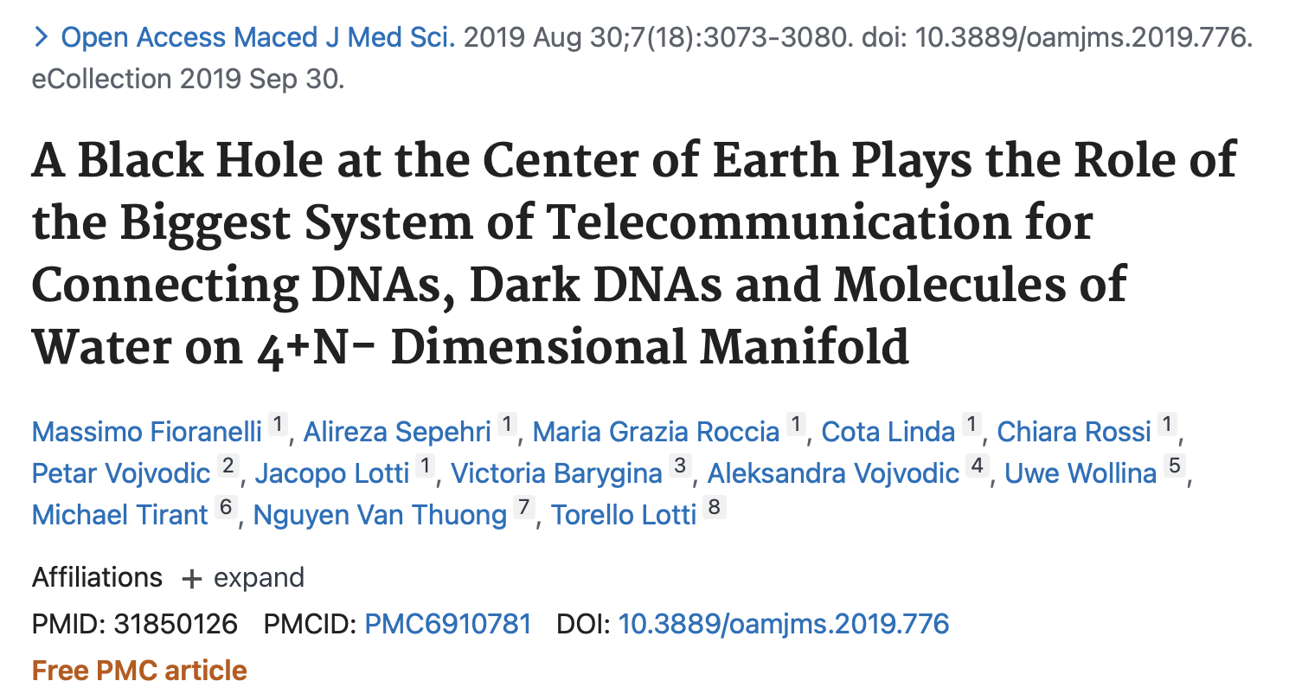
Retraction notice: ”An internal investigation has raised sufficient evidence that they are not directly connected with the special issue Global Dermatology and contain inconsistent results”

Slide 25
Open data

Slide 26

FAIR principles
Findability
Accessibility
Interoperability
Reuse of digital assets
FAIR emphasise machine-actionability (i.e., the capacity of computational systems to find, access, interoperate, and reuse data with none or minimal human intervention
https://www.go-fair.org/fair-principles

Slide 27
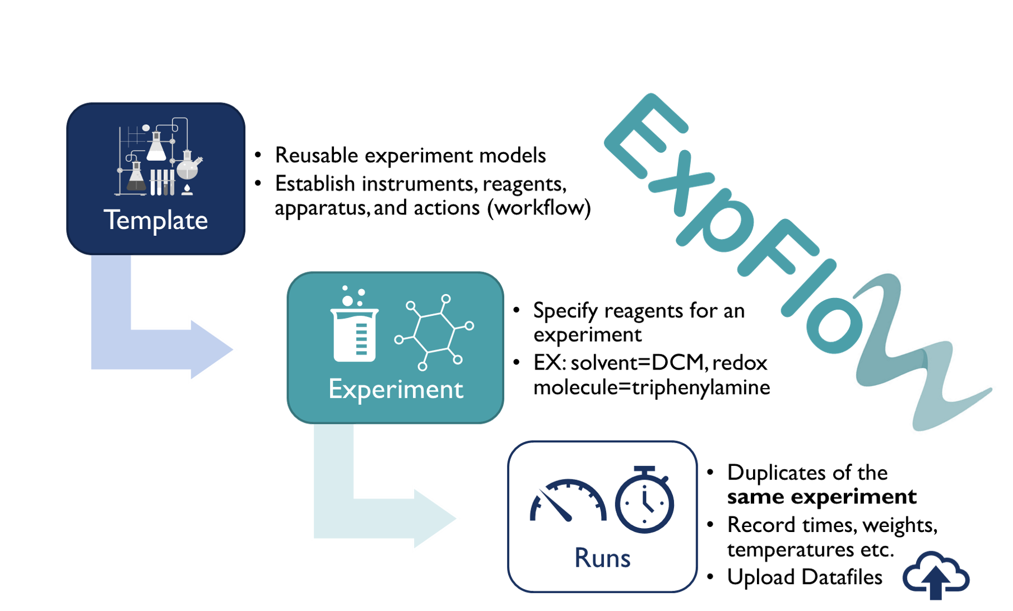
Data and metadata for experimental chemistry
https://knowledgebase.nfdi4chem.de/knowledge_base/
https://d3tales.as.uky.edu/expflow/

Slide 28
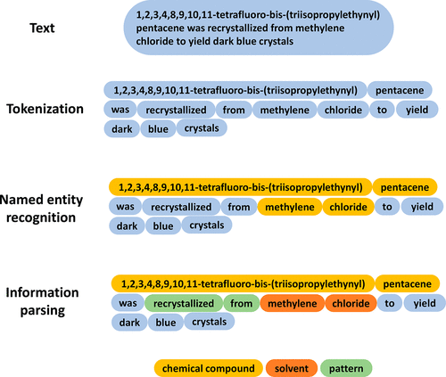
Data and metadata for experimental chemistry
https://knowledgebase.nfdi4chem.de/knowledge_base/
Chem. Mater. 2022, 34, 11, 4821–4827

Slide 29
Open (source) software

Slide 30
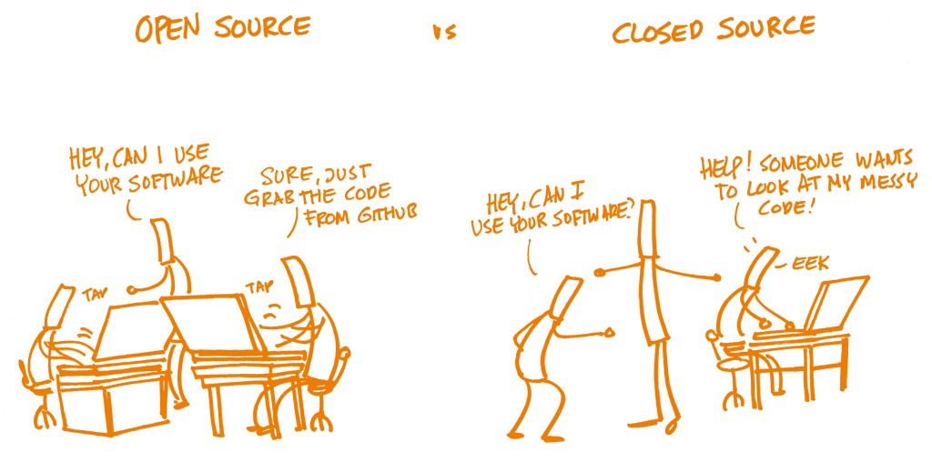
Open Source Software (OSS)
Often, OSS is developed in a public, decentralised, collaborative manner between multiple contributors.

Slide 31
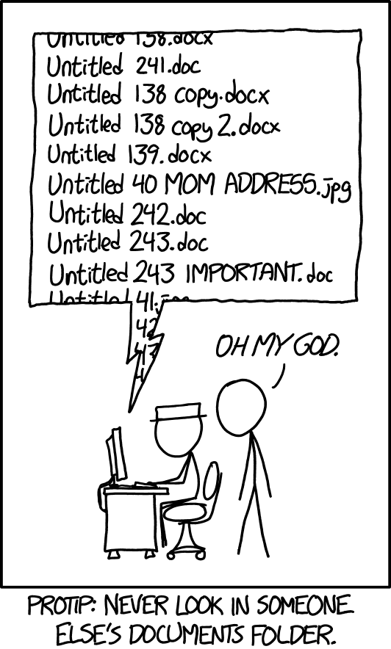
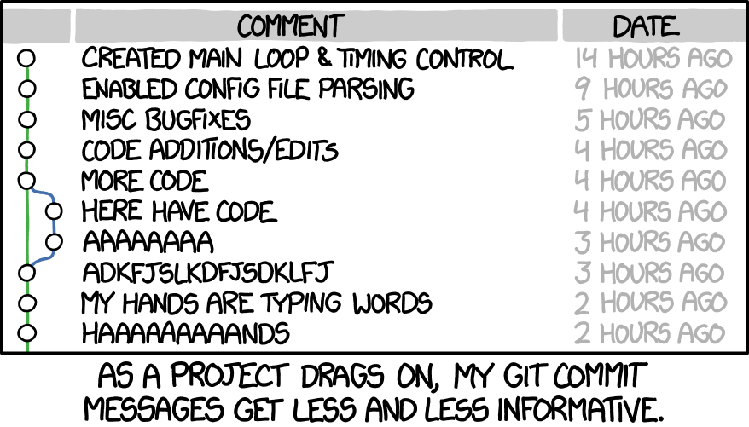
Version control

Slide 32


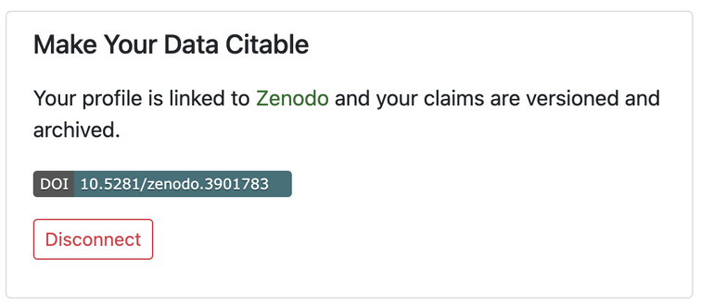
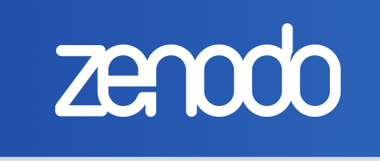
1. Use version control with git/GitHub 2. Put a DOI on it with Zenodo 3. Voila! Your software/dataset can be cited
Publishing and citing software/data
https://github.com/
https://zenodo.org

Slide 33
10 simple rules for reproducible research
For every result, keep track of how it was produced.
Avoid manual data manipulation steps.
Archive the exact versions of all external programs used.
Version control all custom code/spreadsheets/documents..
Record all intermediate results, when possible in standardised formats.
For analyses that include randomness, note underlying random seeds.
Always store raw data behind plots.
Generate hierarchical analysis output, allowing layers of increasing detail to be inspected.
Connect textual statements to underlying results.
Provide public access to software, metadata, and results.
Sandve et al., (2013)
https://github.com/OpenScienceMOOC

Slide 34
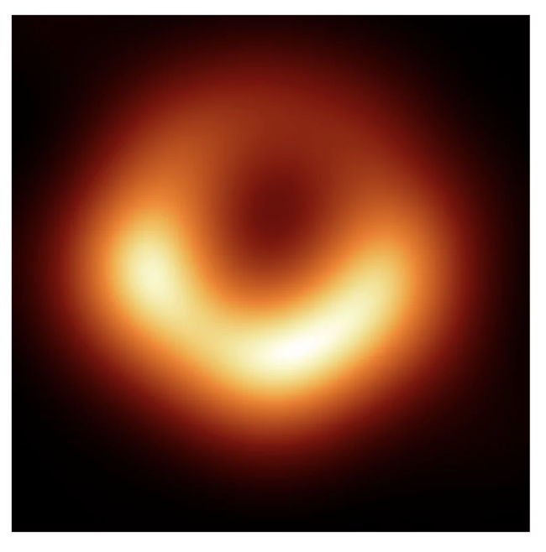
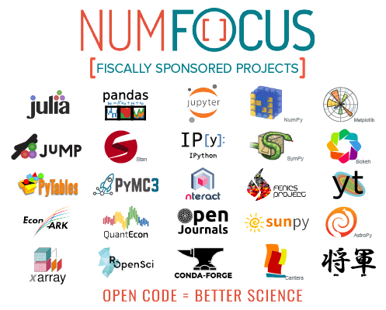
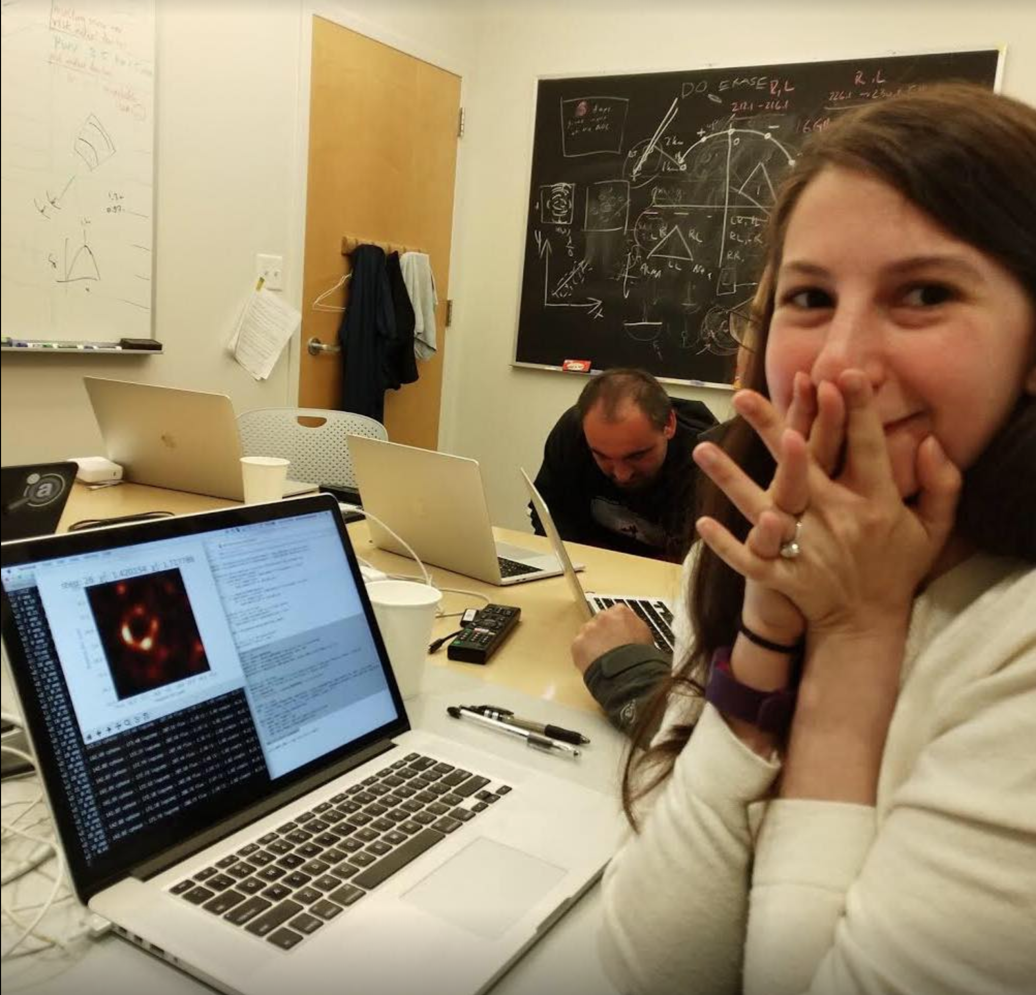
Open-source software powers NASA research
https://tinyurl.com/7ff475an
Disclosure: I receive some funding from NumFOCUS through MDAnalysis
https://tinyurl.com/mw98kmm2

Slide 35
Community science = Open science

Slide 36
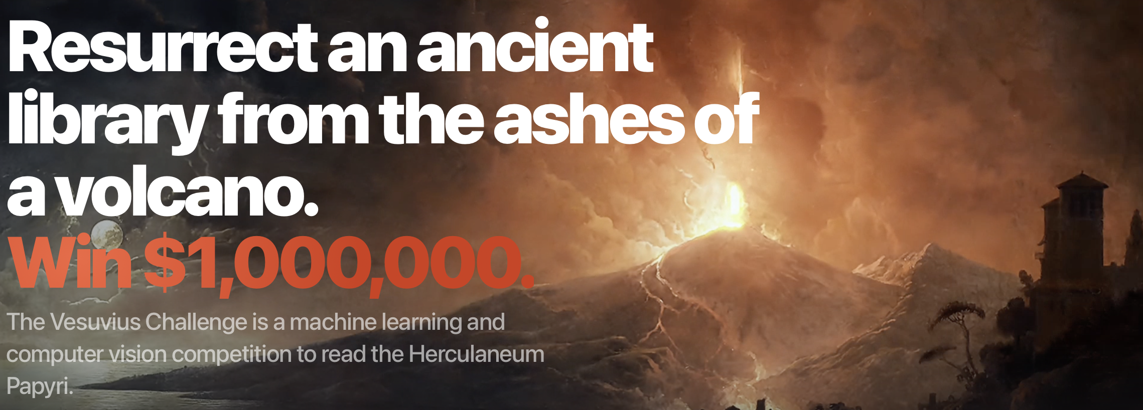
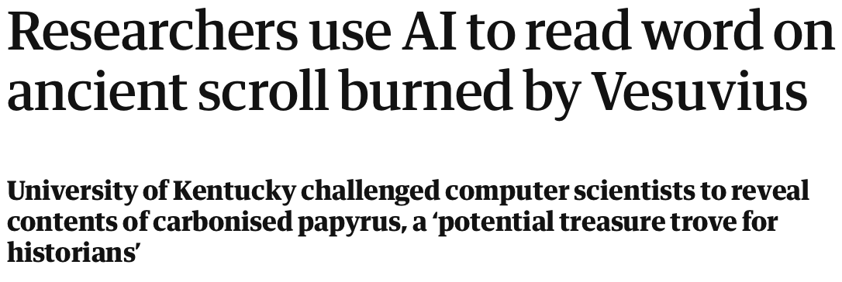
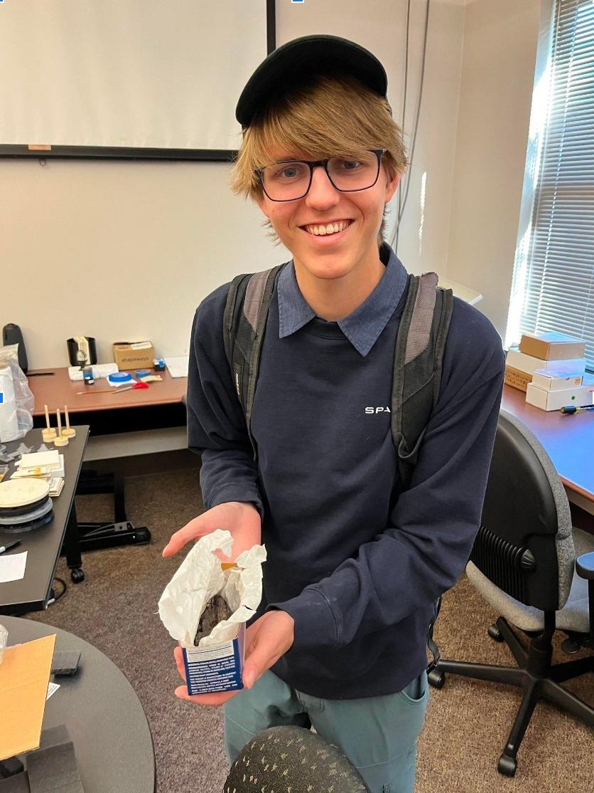
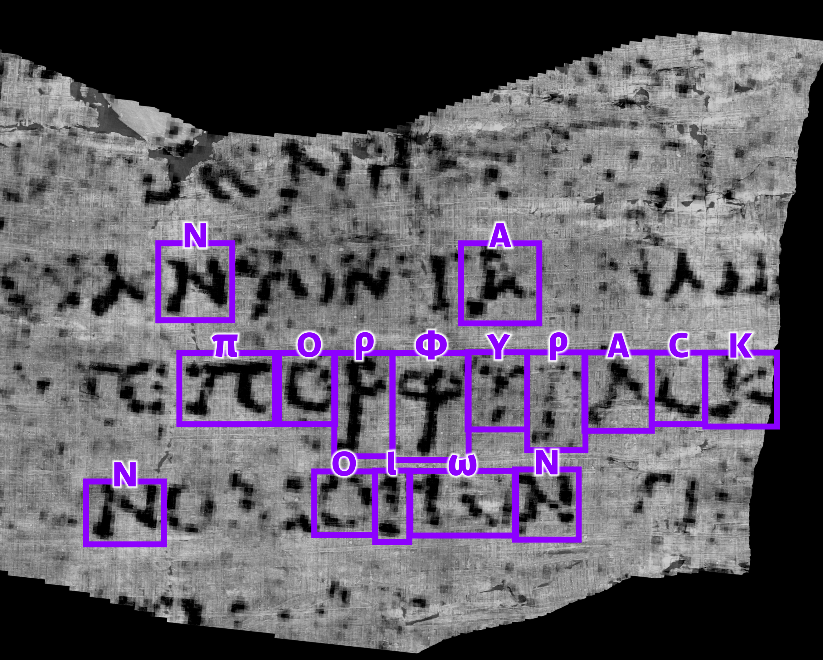
Community science is open science
https://tinyurl.com/34amnnvj
https://scrollprize.org

Slide 37
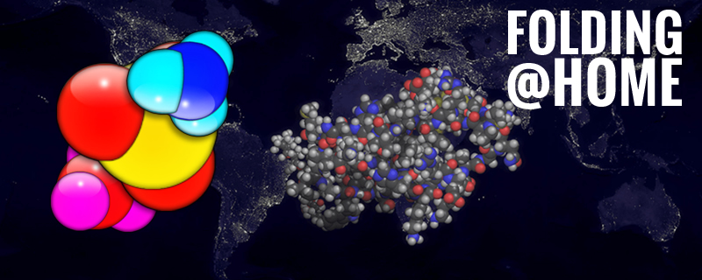
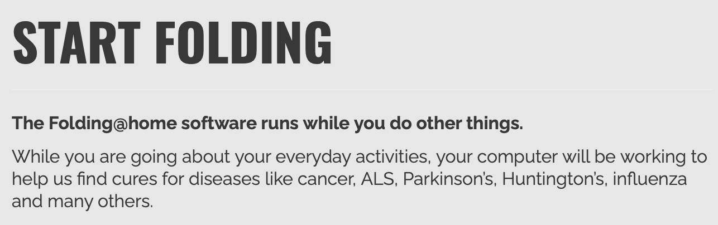
Community science is open science
Folding@home is a distributed computing project that aims to simulate protein folding. Anyone can sign up with their desktop or laptop.
https://en.wikipedia.org/wiki/Folding@home
https://foldingathome.org/
https://tinyurl.com/4jesmm4r

Slide 38
Open to questions!
@micaelamatta
micaela.matta@kcl.ac.uk
Dr Micaela Matta
Lecturer in Computational Chemistry
King’s College London

